Slide 1

ENGR181W: Essay 1
ENGR181W
Spring 2026
The University Writing Program

Slide 2
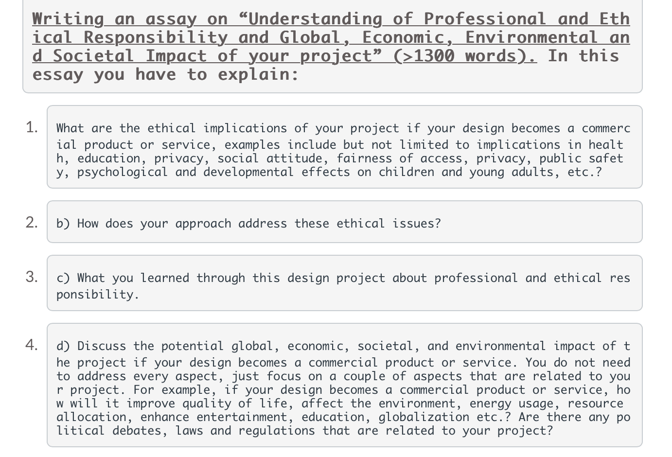
The prompt

Slide 3

Organizing the paper
Abstract, key words
I. Introduction
II. Ethical implications
Implication #1
Implication #2
III. Addressing ethical implications
Implication #1
Implication #2
IV. Professional and ethical responsibility
V. Potential impact of the project
VI. Conclusion
References
Note: This not a literal template. You don’t need to follow this model exactly. Your paper may ultimately look different, but these are the required elements.

Slide 4

Implications can include the following areas (but not limited to):
Health
Education
Privacy
Public safety
Social attitude
Fairness of access/accessibility
Psychological/developmental effects on certain demographics (children, young adults, adults, retirees, etc.)
AI bias/automation
Data ownership
Surveillance

Slide 5
Would you trust a fully self-driving car with no steering wheel? Why or why not?

Slide 6
You need to ask yourself…
What ethical issues might arise from my design choices?
What could go wrong? And what are we going to do about it?
Ethics in engineering means considering how the things you design can help or harm people, and what responsibility you have for those outcomes.
Today, your job is to identify those risks for your project and start thinking about how you’d address them.

